Slide 1
Online Tickets Booking System for a Cricket Match
Group No : 06
2020/ICTS/12 2020/ICTS/14
2020/ICTS/50 2020/ICTS/57
2020/ICTS/122

Slide 2
Content
What is Object Oriented Programming ?
Main Concepts in JAVA
01
03
05
02
04
Introduction
What is JAVA ?
Code explanation

Slide 3
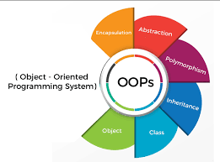
What is Object Oriented Programming ?
Object-oriented programming (OOP) is a programming paradigm that uses objects and their interactions to design applications and computer programs. It is a way of organizing code around data, or objects, rather than functions and logic.
An object is a self-contained entity that contains data and code. The data represents the state of the object, and the code represents the behavior of the object. Objects can interact with each other by sending messages to each other.
OOP has a number of advantages over other programming paradigms, including:
Modularity: OOP programs are made up of modular components, which makes them easier to develop, maintain, and test.
Reusability: OOP objects can be reused in different programs, which saves time and effort.
Maintainability: OOP programs are easier to maintain because the code is modular and the objects are self-contained.

Slide 4

What Is JAVA ?
JAVA
Java is a high-level, class-based, object-oriented programming language that is designed to have as few implementation dependencies as possible. It is a general-purpose programming language intended to let programmers write once, run anywhere (WORA), meaning that compiled Java code can run on all platforms that support Java without the need to recompile. Java applications are typically compiled to bytecode that can run on any Java virtual machine (JVM) regardless of the underlying computer architecture. The syntax of Java is similar to C and C++, but has fewer low-level facilities than either of them.
Key features of the Java
Object-oriented: Java is an object-oriented programming language, which means that programs are made up of objects that interact with each other by sending messages. This makes Java programs easier to develop, maintain, and test.
Platform-independent: Java programs are compiled to bytecode, which is a platform-independent format. This means that Java programs can run on any platform that has a Java virtual machine (JVM).
Secure: Java has a number of security features built in, such as sandboxing and bytecode verification. This makes Java programs more secure than programs written in other languages.
Reliable: Java is a very reliable language. It has a garbage collector that automatically manages memory, and it has a number of other features that make it less prone to errors.

Slide 5
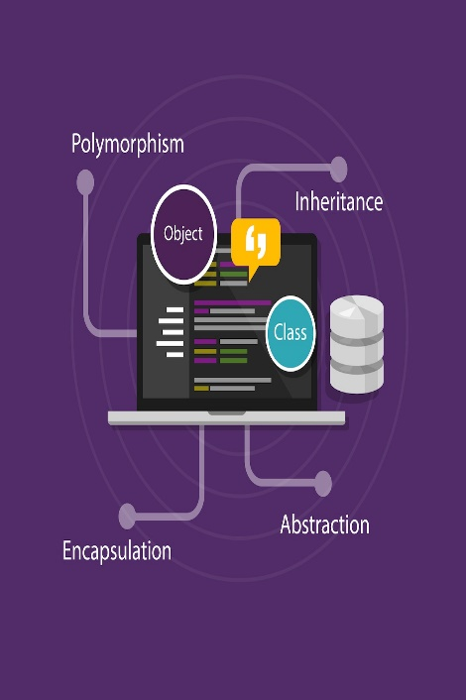

Main Concepts in JAVA
ABSTRACTION
ENCAPSULATION
INHERITANCE
POLYMORPHISM

Slide 6
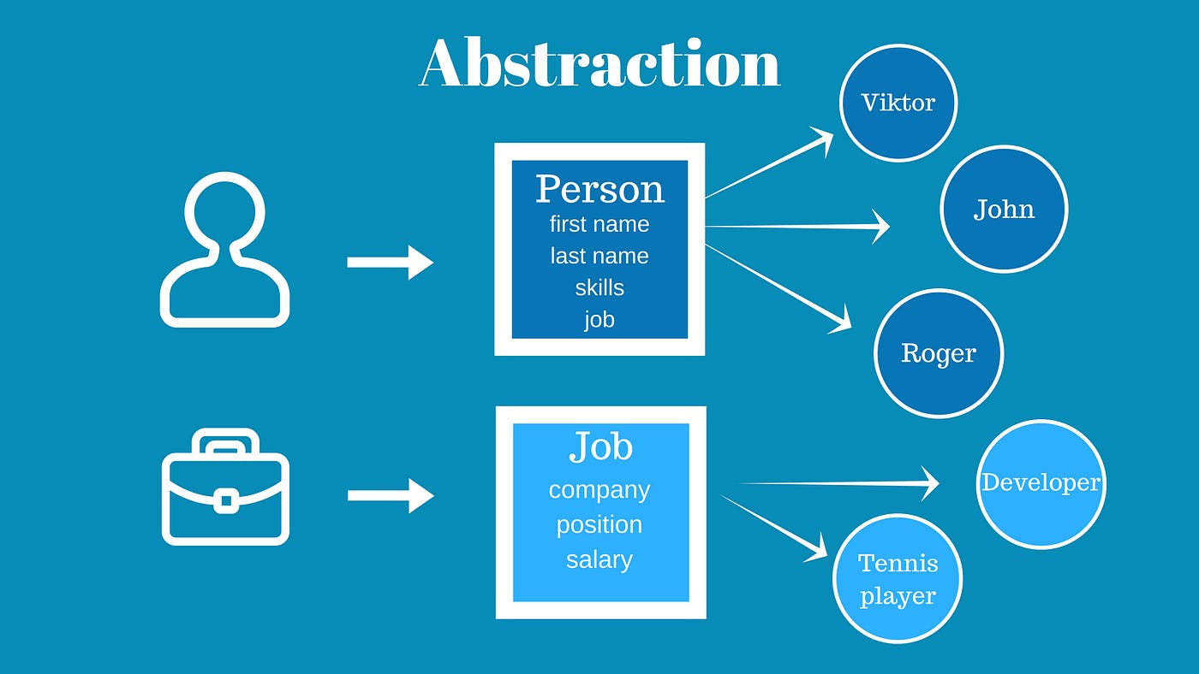
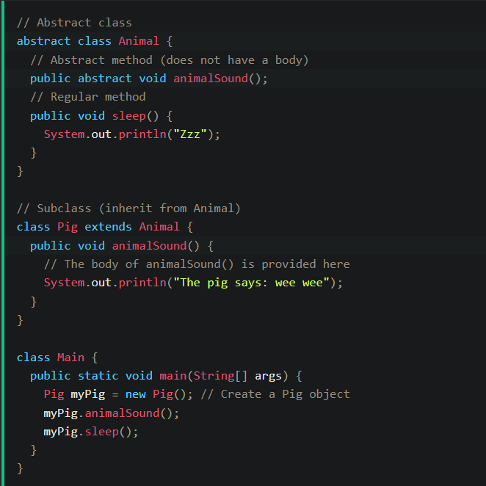
ABSTRACTION
Data abstraction is the process of hiding certain details and showing only essential information to the user.
The abstract keyword is a non-access modifier, used for classes and methods:
Abstract class: is a restricted class that cannot be used to create objects (to access it, it must be inherited from another class).
Abstract method: can only be used in an abstract class, and it does not have a body. The body is provided by the subclass (inherited from).

Slide 7
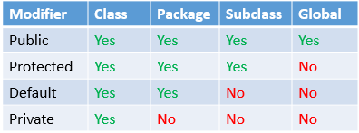
Access Modifiers
PROTECTED
PRIVATE
Content Here
PUBLIC
DEFAULT

Slide 8
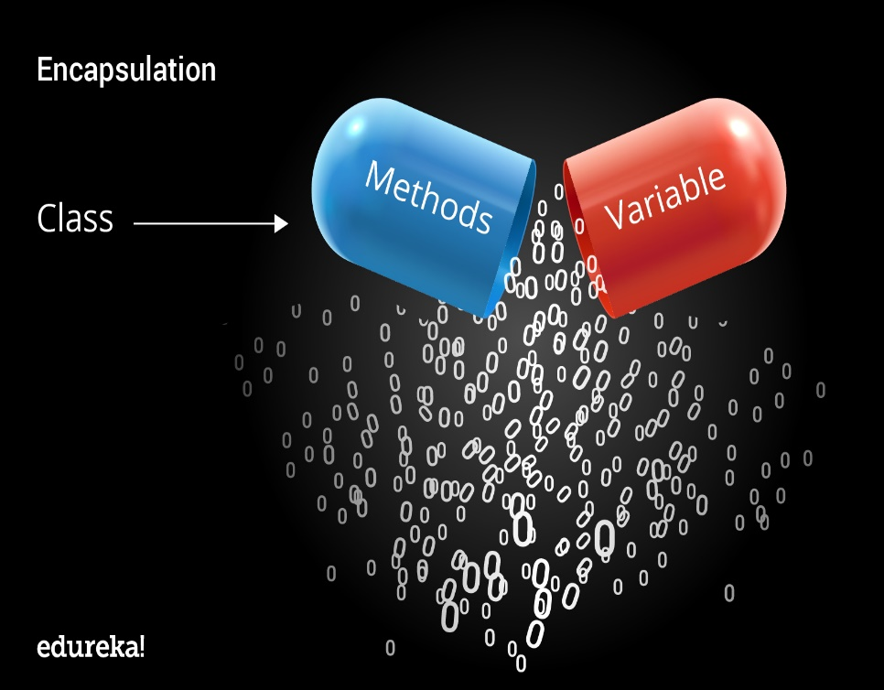
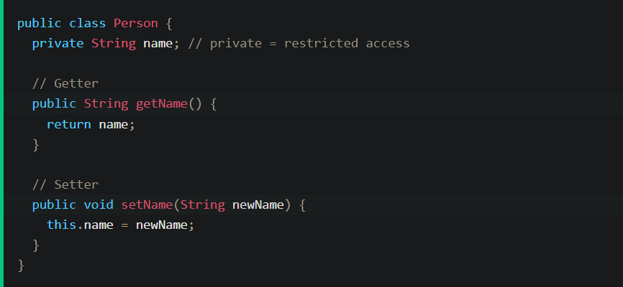
ENCAPSULATION
Encapsulation in java is a process of wrapping code and data together into a single unit. For example, a capsule which is mixed of several medicines.
Advantages of Encapsulation
Provides you the control over the data. Suppose you want to set the value of id which should be greater than 100 only. You can write the logic inside the setter method. You can write the logic not to store the negative numbers in the setter method.
It is way to achieve data hiding in Java because other class will not be access the data through the private data members.
The encapsulation class is easy to test. So, it is better for unit testing.

Slide 9
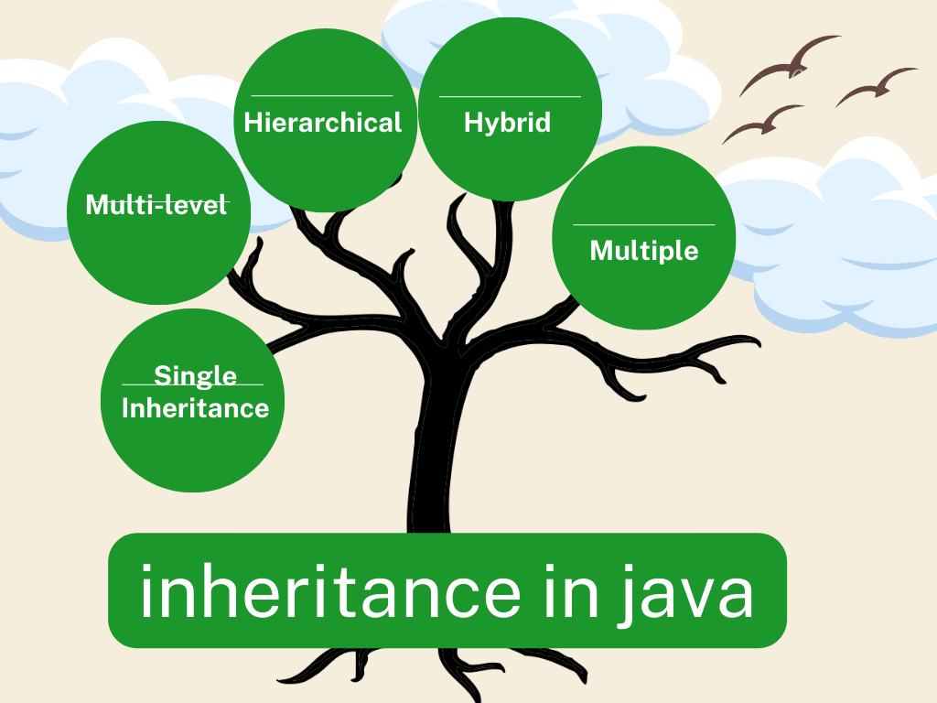
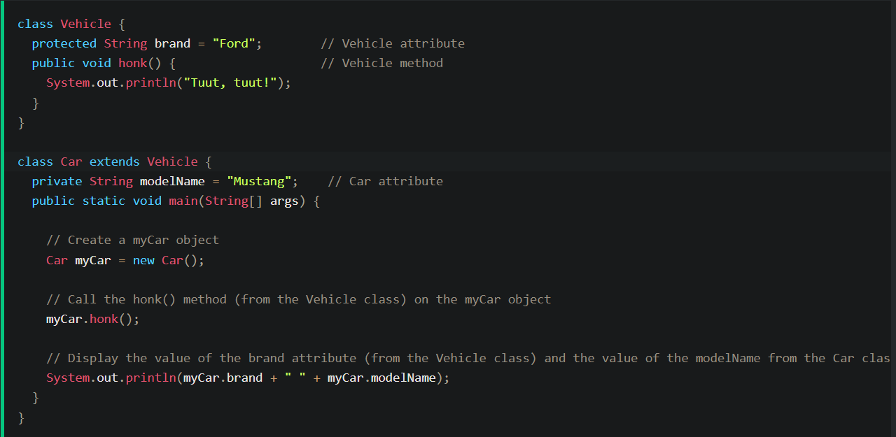
INHERITANCE
Inheritance in Java is a mechanism in which one object acquires all the properties and behaviors of its parent object. This is an important part of OOP.
Why use inheritance in Java?
Terms used in inheritance
Classes
Super class
Sub class
The extends keyword indicates that you are making a new class that derives from an existing class.
There are 4 types of inheritance.
Single
Multilevel
Hierarchical
Hybrid

Slide 10
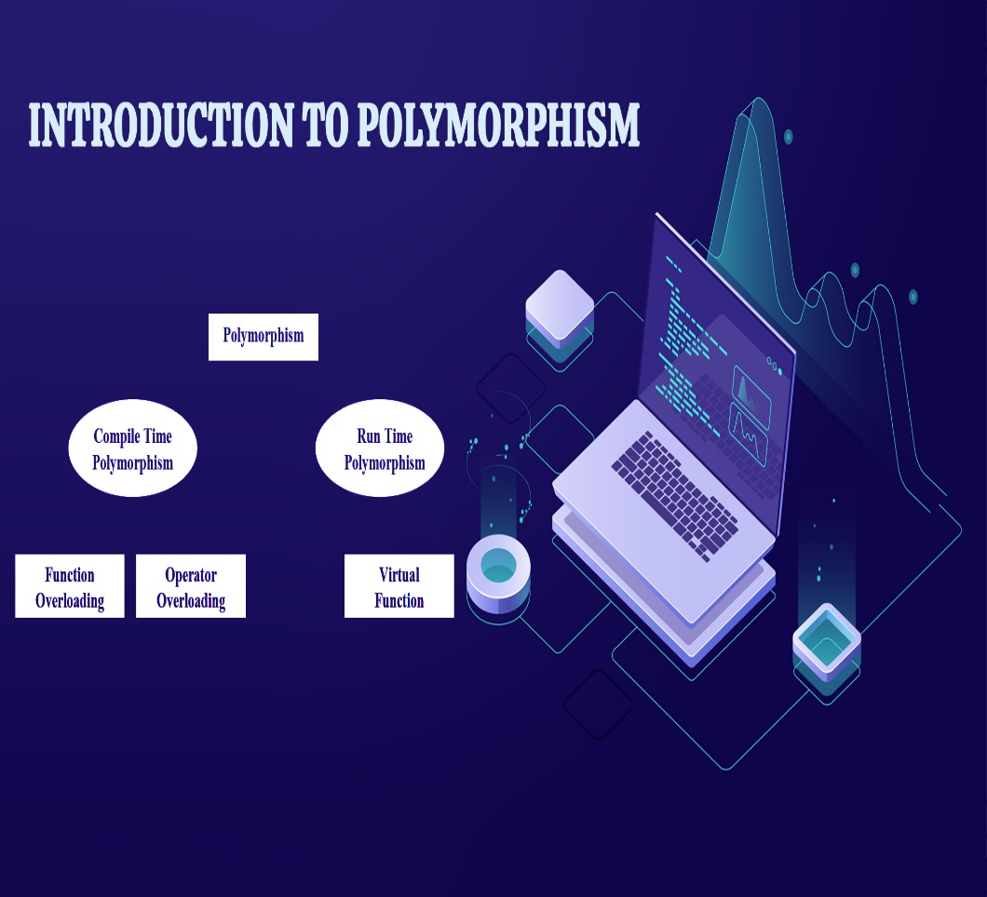
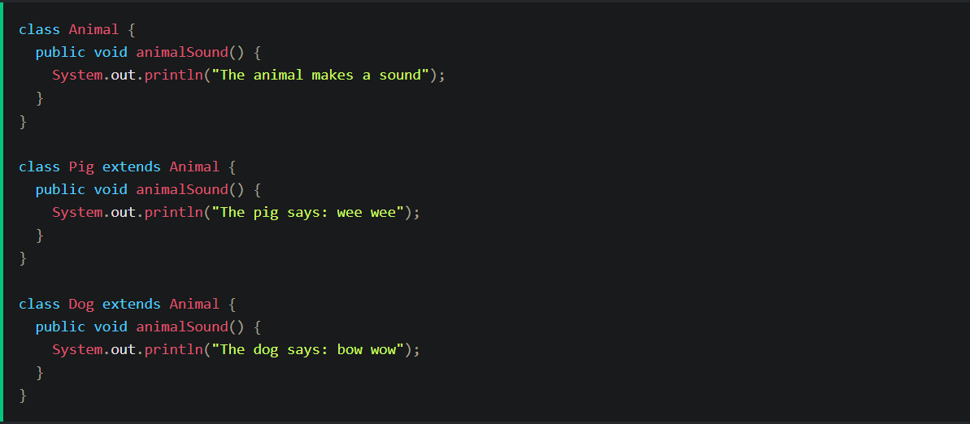
POLYMORPHYSM
Polymorphism is the ability to and object to take on many forms.
The most common use of polymorphism in OOP, occurs when a parent class reference is used to refer to a child class object.
Any java object that can pass more than one IS-A testis considered to be polymorphic .
It is important to know that only possible way to access an object is through a reference variable.
A reference variable can be only one type.
Once declared, the type of reference variable cannot be changed.
A reference variable can refer to any object of its declared as a class or interface type.

Slide 11
Code Explanation
Here is a simplified explanation of the program works :
1
The program displays a menu to the user with the match date, venue, and available seats.
2
The user selects a seat number and quantity of tickets.
3
The program validates the user input for seat number and payment method.
4
The program calculates the total price for the booked tickets.
5
The program displays the payment methods that the user can choose from.
6
The user selects a payment method.
7
The program displays a success message with the total price paid.

Slide 12
THANK YOU !

